Slide 1
Landing Page Optimization
Convert Every Lead into Opportunity

Slide 2
Agenda
What is Landing Page?
Types of Landing Page
What is Landing Page Optimization?
AIDA Model
Fogg Behavior Model
The Limbic System
5 Second Test
Landing Page Optimization Checklist

Slide 3
What is Landing Page?
In online marketing, a landing page, sometimes known as a "lead capture page", "static page", or a "destination page", is a single web page that appears in response to clicking on a search engine optimized search result, marketing promotion, marketing email, or an online advertisement.
A landing page may be part of a microsite or a single page within an organization's main web site.
The purpose of a landing page is to expand upon the message of the advertisement or link and convince the visitor to “convert” into becoming a customer by taking a specific action.

Slide 4
Types of Landing Page
References
A reference landing page presents information that is relevant to the visitor. These can display text, images, dynamic compilations of relevant links, or other elements.
Examples: Provide Information About the Category, Provide Brand Information
Transactional
The purpose of the transactional landing page is to persuade a visitor to take an action by completing a transaction.
This is accomplished by providing a form that needs to be filled out. The visitor information is obtained in order to add the visitor's email address to a mailing list as a prospect. An email campaign can then be developed based on responses to transactional landing pages. The goal is to capture as much information about the visitor as possible. Further to convert the visitor into a customer

Slide 5
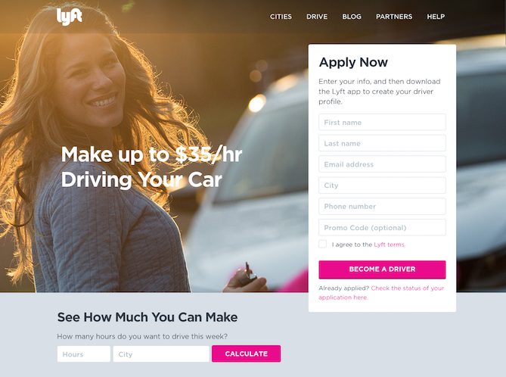
Examples of Landing Page
Lyft's landing page, they zero in on their drivers' main motivation: earning money easily.
"Apply Now" form, drivers can type their city and the number of hours they might drive for Lyft in a week to calculate how much they'd make.
When visitors fill out that information and press "Calculate," they aren't taken to a new page. Instead, they see a dollar amount followed by a new call-to-action button to "Apply Now" (which, once clicked, takes drivers up to the form).
By offering these two conversion paths, they're able to address two different types of people in the conversion path: those who are ready to make the decision now and those who need a little more information before they convert.

Slide 6
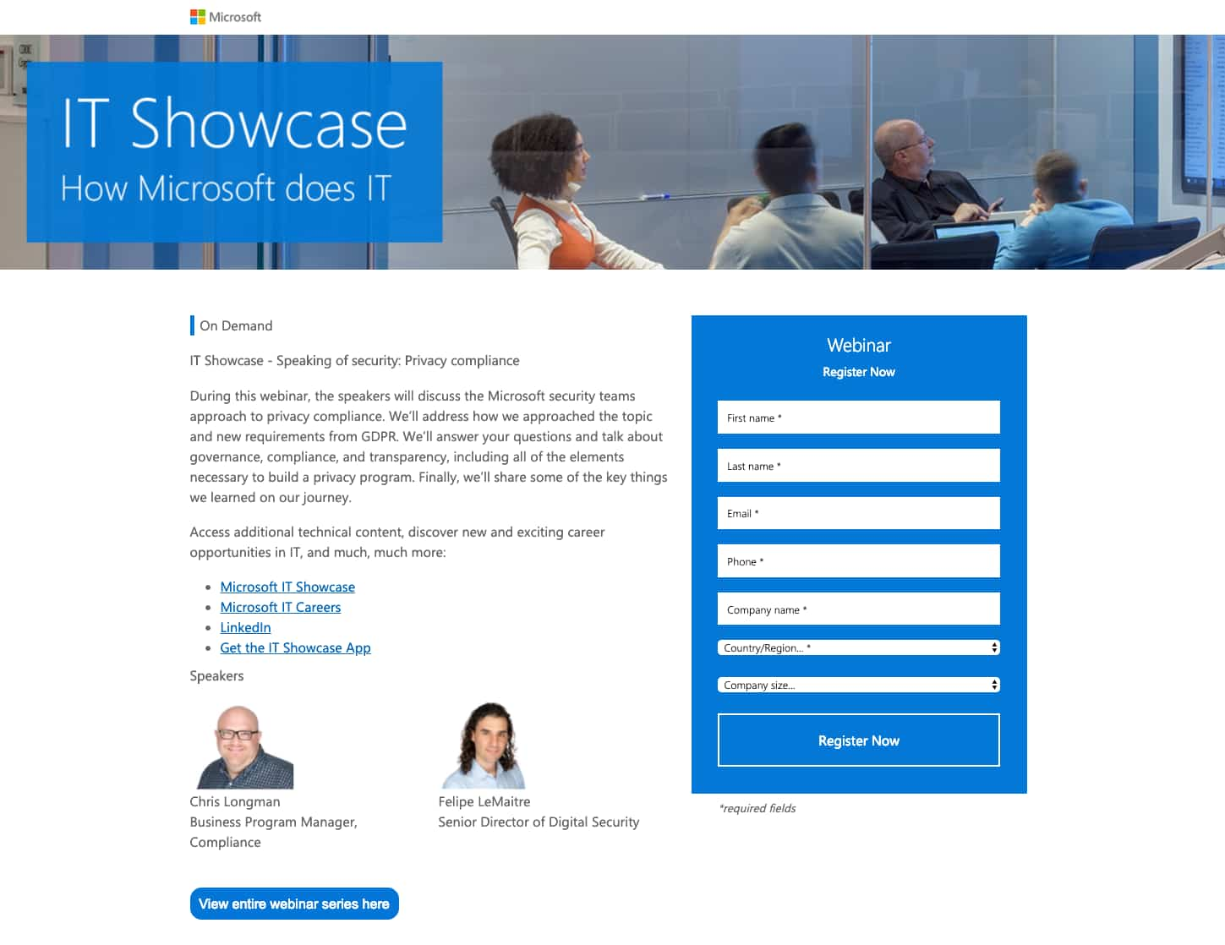
Examples of Landing Page
This simple and straightforward design does a great job of presenting why the webinar being offered is important to IT professionals.
Along with a quick blurb describing what the webinar will discuss, the page also includes links to similar webinars, details on the speakers, and links to Microsoft resources that touch on the topics that will be discussed.

Slide 7
Examples of Landing Page
Khan Academy's homepage does that very well. This page is clearly designed for three different types of visitors: those who want to learn something, those who want to teach, and parents who are interested in using Khan Academy for their kids. Plus, how motivational is the emblazoned "You can learn anything" text at the top?

Slide 8
What is Landing Page Optimization?
Landing page optimization refers to the process of enhancing or improving each element on your landing page to increase conversions. Instead of redesigning the entire page based solely on a hunch, you use data and anecdotal evidence.
Notes:
anecdotal - Anecdotal evidence is evidence from anecdotes: evidence collected in a casual or informal manner and relying heavily or entirely on personal testimony

Slide 9
AIDA Model
Awareness: creating brand awareness or affiliation with your product or service. The product must attract the consumer's attention. It is a type of “eyecatcher.”
Interest: Generating interest in the benefits of your product or service, and enough interest to encourage the buyer to start to research further.
Desire: Showing ‘emotional connection' in your product or service. Move the consumer from 'liking' it to 'wanting it’.
Action: Call To Action - Move the buyer to interact with your company and taking the next step i.e. downloading a brochure, making the phone call, joining your newsletter, or engaging in live chat, etc.
The AIDA model was developed by the American businessman, E. St. Elmo Lewis, in 1898. The original main purpose was to optimize sales calls, specifically the interaction between seller and buyer concerning the product.

Slide 10
Purchase Funnel
Awareness
Articles
Webinars
Advertisements
Paid search/ Landing Pages
Market Potential
Interest
Web Content
Newsletter
Social Media/Blogs
Email Campaigns
Suspects
Prospects
Desire
White Papers
Brochures
Microsites
Actual Customers
Testimonials
Case Studies
Action

Slide 11
Fogg Behavior Model
Psychologist. BJ Fogg is the founder of the Persuasive Technology Lab at Stanford University in California
Fogg condensed his findings on how to change behavior into a model which he named: the Fogg Behavior Model.
Three behavior change elements are the following:
Motivation - People have to be sufficiently motivated to change their behavior.
Ability - They must have the ability to do the behavior.
Trigger - They have to be triggered, or prompted, to do the behavior.
B = MAT
(Behavior = Motivation + Ability + Trigger)
(If one of the elements is missing, behavior won’t happen)

Slide 12
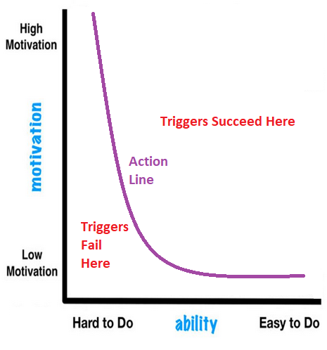
Fogg Behavior Model
As a person’s motivation and ability to perform the target behavior increase, the more likely it is that they will perform said behavior.
There’s an inverse relationship between motivation and ability. The easier something is to do, the less motivation is needed to do it. On the other hand, the harder something is to do, the more motivation is needed.
The action line—the purple curved line—lets you know that any behavior above that line will take place if it’s appropriately triggered. At the same time, any behavior below the line won’t take place regardless of the trigger used. Why is that? Because if you have practically zero motivation to do something, you won’t do it regardless of how easy it is to do. At the same time, if you’re very motivated to do something, but it’s incredibly difficult to do, you’ll get frustrated and you won’t act.

Slide 13
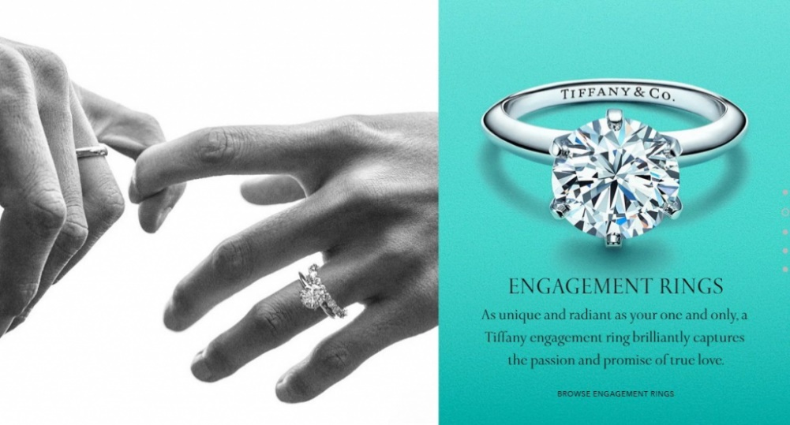
Fogg Behavior Model
Motivation
In a marketing environment the emotional backdrop that creates the desire for the consumer to continue along the sales funnel.
Depending on the specific product or service, motivation could be driving a consumer towards making a purchase.
Like downloading an eBook or white paper, subscribing to a newsletter, or anything else that will ultimately drive ROI.
This page from Tiffany & Co embodies the emotion involved in a couple’s engagement, providing ample motivation for the user to click through and progress through the funnel

Slide 14
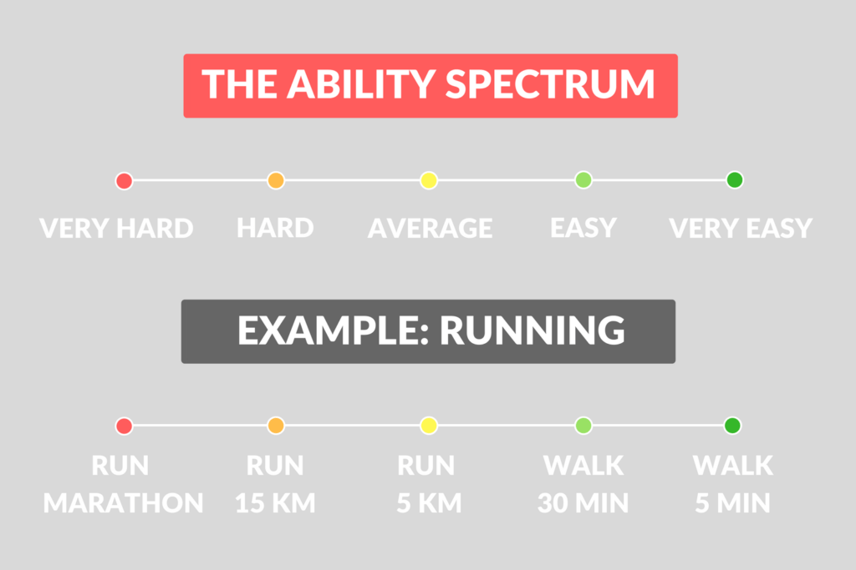
Fogg Behavior Model
Ability
It is more clearly defined than motivation and can ultimately be determined by concepts as simple and straightforward as affordability or necessity.
A landing page designed to maximize impact on a company’s bottom line needs to present the product or service in a reasonable context to the individual to make it seem attainable within their lifestyle.

Slide 15
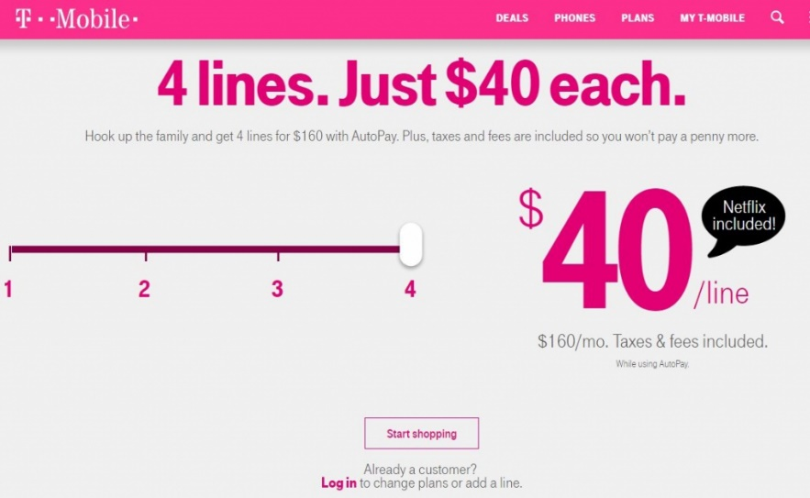
Fogg Behavior Model
T-Mobile makes affordability of a multiple phone account the focal point of the ad. Within the context of Fogg’s Behavior Model, this increases a customer’s perception of their ability to afford the plan and. Thus, increases the likelihood of a conversion to sale

Slide 16
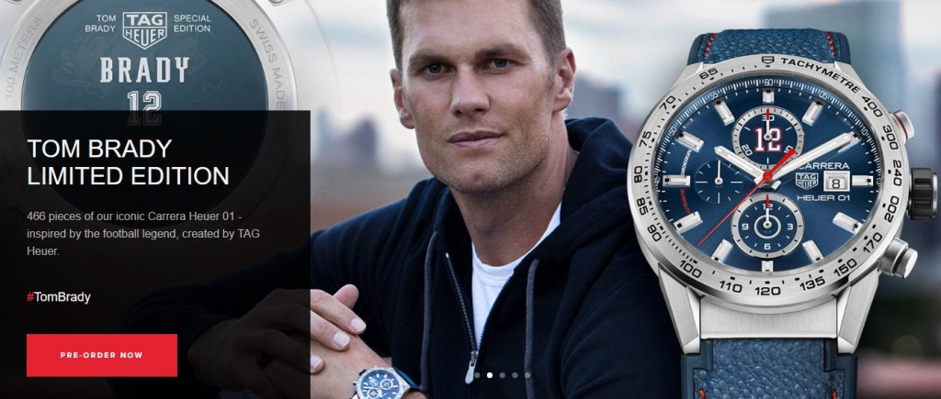
Fogg Behavior Model
Trigger
The trigger point in the context of a post-click landing page is the most clearly defined of the three main elements required within Fogg’s Behavior Model. Personified by a bold, concise, and attention-grabbing call-to-action, the trigger is what ultimately prompts the consumer to take action.
The CTA on this Tag Heuer page draws focus to the pending product and uses the celebrity influence to persuade users to click through and pre-order the watch

Slide 17
The Limbic System
Dr. Hans-Georg Housel designed the Limbic concept in the late 1990s. He had three main objectives in mind
It is meant to be a holistic approach that combines and links the findings of various scientific disciplines dealing with human behavior and decision-making. A larger context was to be established.
It is supposed to be as simple and user-friendly as possible for marketing and sales, so that it is also useful for human behavior even without scientific knowledge.
It should use a consistent and clear symbolism so that the essence of the concept is captured and understood by as many readers as possible.
The limbic system is a set of structures in the brain that deal with emotions and memory

Slide 18
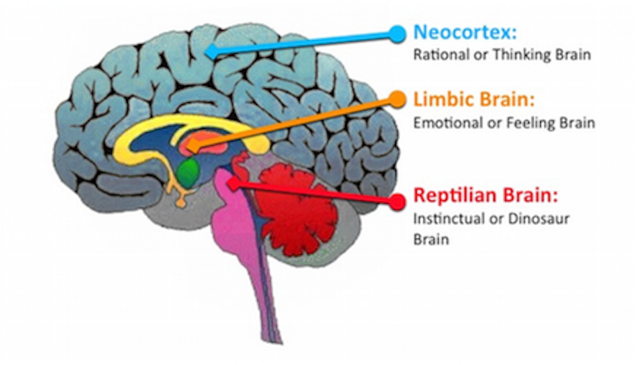
Limbic Brain Map
The reptilian brain is responsible for survival reflexes such as hunger, breathing and other bodily functions.
The limbic system views the environment in black and white; it generally processes information and makes decisions somewhat automatically and quickly as compared to the neocortex
The neocortex is the part of our brain that makes us intelligent, processes language, logic, decisions and control of emotions.
In evolutionary terms, the neocortex is a much more recent in development, and it is actually bigger in humans than in other animals
For example, if you suddenly hear a loud bang, your limbic system (or core) will instinctively crave for safety and will tell you to be afraid. Your neocortex will, however, analyze and rationalize the context of the situation and make the final call as to whether it is harmless ‘thunder,’ if it was raining, or if we should run away as a result of an explosion

Slide 19
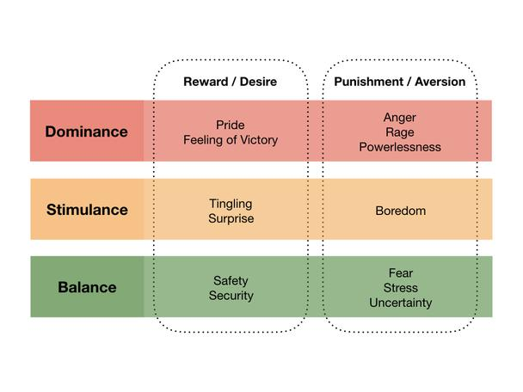
Limbic Model
Balance (objectives: security, stability, order)
Dominance (objectives: power, status, enforcement)
Stimulant (objectives: curiosity, adventure, reward)

Slide 20
Limbic Map
Hedonist - Curious, spontaneous, fun, creative, individually, extroverted, loves diversification
Adventurer - Impulsive, adventurous, autonomous, rebellious, likes challenges.
Performer - performance-oriented, focus on success, ambitious, status-oriented, wants to establish oneself.
Disciplined - frugal, reasonable, disciplined, precise, dutiful, logical, prefers clear structure
Traditionalist - traditional, modest, decent, structured, wants to safeguard himself against everything
Harmonizer - family-oriented, harmony-oriented, caring, cordial, needs feeling of security.
Open minded - feeling good, open-minded, fanciful and dreaming, flexible, broad-minded, loves enjoying with all his senses.

Slide 21
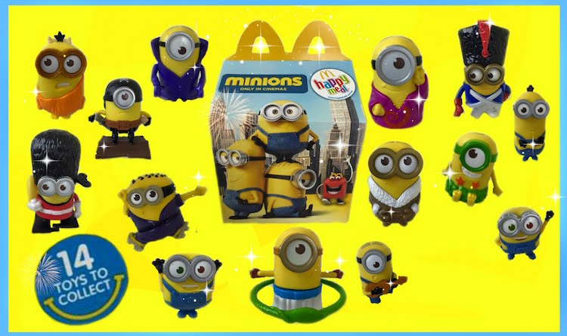
Example of Limbic System
McDonald’s used to use toys in their Happy Meal commercials to lure children to come to their restaurants. It combined the elements of entertainment (by including interesting kids toys), empathy (knowing that toys make kids happy and if kids are happy, their parents are also equally happy)

Slide 22
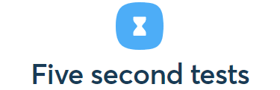
5 Second Test
A 5-second test is a usability test in which a participant is shown the user interface of a screenshot of your website, product, graphic design, app design, prototype, wireframe, logo, landing page, a banner, an app menu for five seconds.
After the 5-second test, the participant is then asked what he can remember from the layout he has seen. This is a particularly useful method to see whether key visuals or call-to-action buttons have the right impact on the user.

Slide 23
5 Second Test
With a 5 second test you can get immediate feedback about your design and copy – based only on this first impression
Do people understand the product or service ? / Do you users get your main message or not ?
Do people feel they will receive a benefit from the page ? / Does your brand look trustworthy or not ?
Can people recall the company or product name ? / Do people understand your main product or not ?
When is a 5 second test useful?
Five second testing is useful in two cases.
Before Product Release
The first one is when you’re building a brand-new website, product, campaign, landing page, banner etc.
It is very important to get early feedback about the overall user experience and design. The 5 second test are perfect for that. Test will help the team to go in the right direction from the very beginning of the product development process.

Slide 24
5 Second Test
Product idea initiation
Team brainstorms about the different possible designs and copies
Come up with 5 to 10 different variations
Run five second tests for each version
Get feedback, learn, iterate and finally improve

Slide 25
5 Second Test
Decide web material for A/B testing like web pages, banner, landing pages etc.
2) Before an A/B Testing
A/B testing takes time. It takes engineering time from your developers. Most small or mid-size online businesses don’t have time, budgets to wait 2-3 weeks, a month or even more
My website is small, don’t have budgets and time for A/B Testing
But if you run a five second test before your A/B test, you can get immediate feedback about your different variations and get rid of those that perform really badly on this qualitative part.
In above case 5 Second Test is helpful

Slide 26
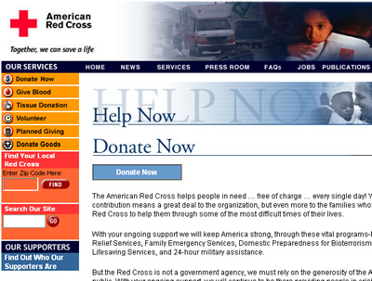
Example of 5 Second Test
Before Test:
The Red Cross.org Donation content page needs to communicate to users all of their contribution options

Slide 27
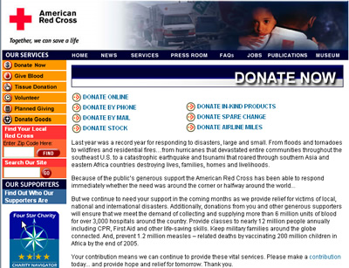
Example of 5 Second Test
After Test:
With the redesigned version of the Donation content page, users readily recalled the complete set of donation options with only 5 seconds to view the page.

Slide 28
Landing Page Optimization Checklist
Here’s a quick checklist to follow when building your landing page:
Plan your optimization strategy in advance
Simplify your landing page design
Use contrasting colors
Is 5 second test has been done?
Write a headline that uses action words.
Make sure the body of your content is easily scannable and contains the primary benefits of your product or service.
Use images and videos to help bring points home and hold attention
Make sure your landing page is mobile-friendly. This is especially important for email campaigns since many visitors’ first interaction with your email will be through their phone.
If appropriate, remove the top navigation menu from the page to stop visitors from wandering to other pages on your site.
Write a strong call to action that is straightforward but not overly aggressive and makes it clear what the visitor will receive.

Slide 29
Landing Page Optimization Checklist
Remove any unnecessary fields from your contact form.
Ensure social media sharing buttons are clearly visible to encourage browsers to spread the word about you.
Double check that the form, thank you page, autoresponders and any downloadable content work correctly.
Use scarcity techniques
Add contact information
Add testimonials
Try different form lengths

Slide 30
References
https://en.wikipedia.org/wiki/AIDA_(marketing)
https://www.smartinsights.com/traffic-building-strategy/offer-and-message-development/aida-model/
https://en.wikipedia.org/wiki/Landing_page
https://encrypted-tbn0.gstatic.com/images?q=tbn%3AANd9GcQD4Kc7M-f_2OvEpJgKvIdZNftb-awb4JQIdg&usqp=CAU
https://en.ryte.com/wiki/Limbic%C2%AE_Personas#The_Limbic.C2.AE_map
https://www.bigcommerce.com/blog/marketing-psychology/#undefined
https://lemons.ge/en/blog/51-branding/170-how-to-influence-emotions-with-marketing-part-2
https://daringtolivefully.com/the-fogg-behavior-model
https://instapage.com/blog/bj-fogg-behavior-model
https://www.growthengineering.co.uk/bj-foggs-behavior-model/
https://articles.uie.com/five_second_test/#:~:text=A%20simple%20usability%20testing%20technique,to%20gather%20their%20initial%20impressions.
https://data36.com/five-second-testing/
https://blog.hubspot.com/marketing/fantastic-landing-page-examples
https://unbounce.com/landing-pages/checklist/
https://www.prontomarketing.com/blog/10-point-landing-page-optimization-checklist-for-small-businesses/#:~:text=Your%20landing%20page%20optimization%20checklist&text=Make%20sure%20the%20body%20of,landing%20page%20is%20mobile%2Dfriendly.

Slide 31
Thank You!
For any queries connect me at jatinkochhar@hotmail.com

